Slide 1

Vivekanand Education Society’s Institute Of Technology
Department Of Information Technology
DSA mini Project
A.Y. 2024-25
Sustainability Growth:-Enhance customer engagement through transparent billing.
GROUP MEMBERS
Diya Nagdev-33
Bhavik Panjapi-39
Karthik Pandita-38
Guided By:-Mrs. Kajal Jewani

Slide 2


Vivekanand Education Society’s Institute Of Technology
Department Of Information Technology
DSA mini Project
A.Y. 2024-25
Telecom Billing System: A Mini Project in Data Structures and Algorithms
This mini project explores the application of data structures and algorithms in the context of a Telecom Billing System. It showcases efficient data storage and management techniques using a queue data structure to handle customer billing records and transactions.

Slide 3
Vivekanand Education Society’s Institute Of Technology
Department Of Information Technology
DSA mini Project
A.Y. 2024-25
Introduction to Telecom Billing System
Overview
Importance
Challenges
The Telecom Billing System is a critical component of any telecommunications service provider, responsible for accurately capturing, storing, and processing customer usage data to generate timely and reliable bills.
Effective billing systems are essential for telecom companies to maintain customer satisfaction, ensure accurate revenue collection, and comply with industry regulations.
Managing large volumes of real-time data, handling complex tariff structures, and providing secure and user-friendly interfaces are some of the key challenges in telecom billing.

Slide 4

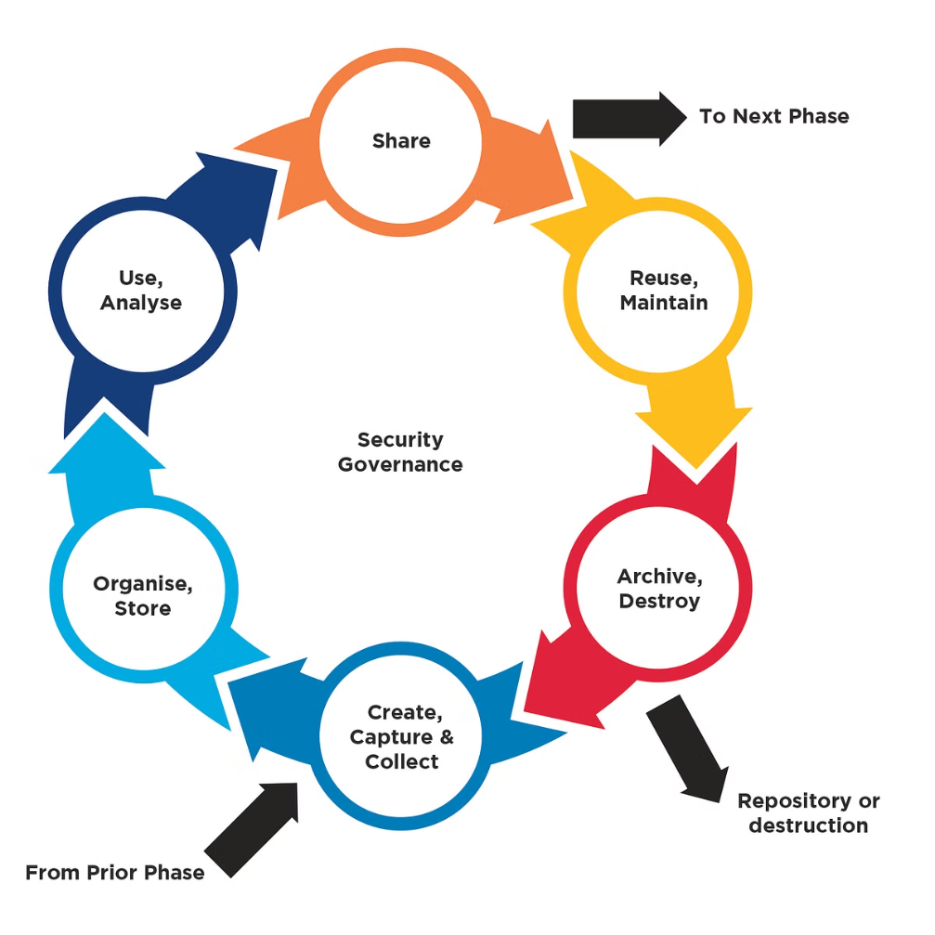
Vivekanand Education Society’s Institute Of Technology
Department Of Information Technology
DSA mini Project
A.Y. 2024-25
Problem Statement: Efficient Data Storage and Management
1
Data Volume
2
Data Structures
Telecom companies deal with massive amounts of customer usage data that needs to be captured, stored, and processed efficiently.
Selecting the right data structures and algorithms is crucial for handling the high-volume, real-time nature of telecom billing data.
3
Scalability
The billing system must be able to scale to accommodate growing customer bases and increasing data loads without compromising performance.

Slide 5
Vivekanand Education Society’s Institute Of Technology
Department Of Information Technology
DSA mini Project
A.Y. 2024-25
Objectives of the Project
Efficient Data Storage
Real-Time Processing
Scalability and Performance
Implement a queue data structure to store and manage customer billing records and transactions.
Develop algorithms to process billing data as it arrives, enabling timely and accurate invoice generation.
Ensure the system can handle growing data volumes and user demands without compromising speed and reliability.

Slide 6





Vivekanand Education Society’s Institute Of Technology
Department Of Information Technology
DSA mini Project
A.Y. 2024-25
Software Requirements: Language, Tools, and Frameworks
C Language
The project will be implemented using the C programming language, known for its efficiency and low-level control.
Data Structures
Leveraging the queue data structure to store and manage billing records and transactions.
Testing
Thorough unit and integration testing will ensure the reliability and correctness of the billing system.

Slide 7

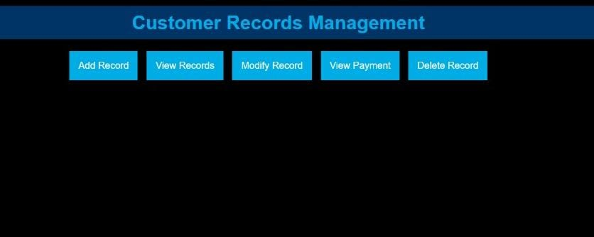
Vivekanand Education Society’s Institute Of Technology
Department Of Information Technology
DSA mini Project
A.Y. 2024-25
Frontend Design: User Interface and Interactions
Customer Portal
Admin Dashboard
Mobile Responsiveness
Intuitive web-based interface for customers to view their billing history, make payments, and manage their account details.
Comprehensive management console for telecom company staff to monitor billing activities, generate reports, and handle customer inquiries.
Ensure the billing system is accessible and user-friendly on both desktop and mobile devices to cater to diverse customer preferences.

Slide 8

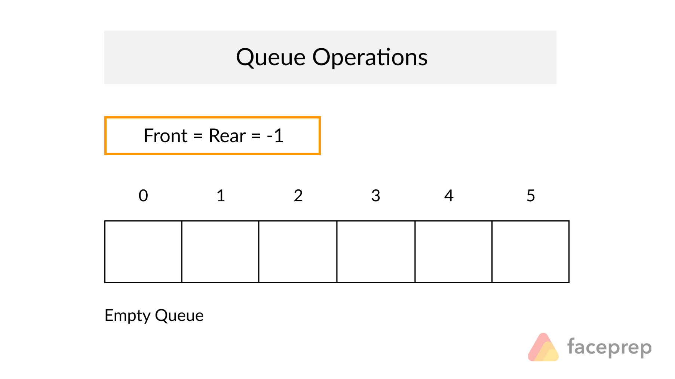
Vivekanand Education Society’s Institute Of Technology
Department Of Information Technology
DSA mini Project
A.Y. 2024-25
Data Storage and Manipulation: Implementing a Queue
1
Enqueue
Efficiently add new billing records and transactions to the queue as they are generated.
2
Dequeue
Retrieve and process the oldest billing records from the queue to generate customer invoices.
3
Maintenance
Implement queue management operations, such as size monitoring, overflow handling, and periodic data archiving.

Slide 9


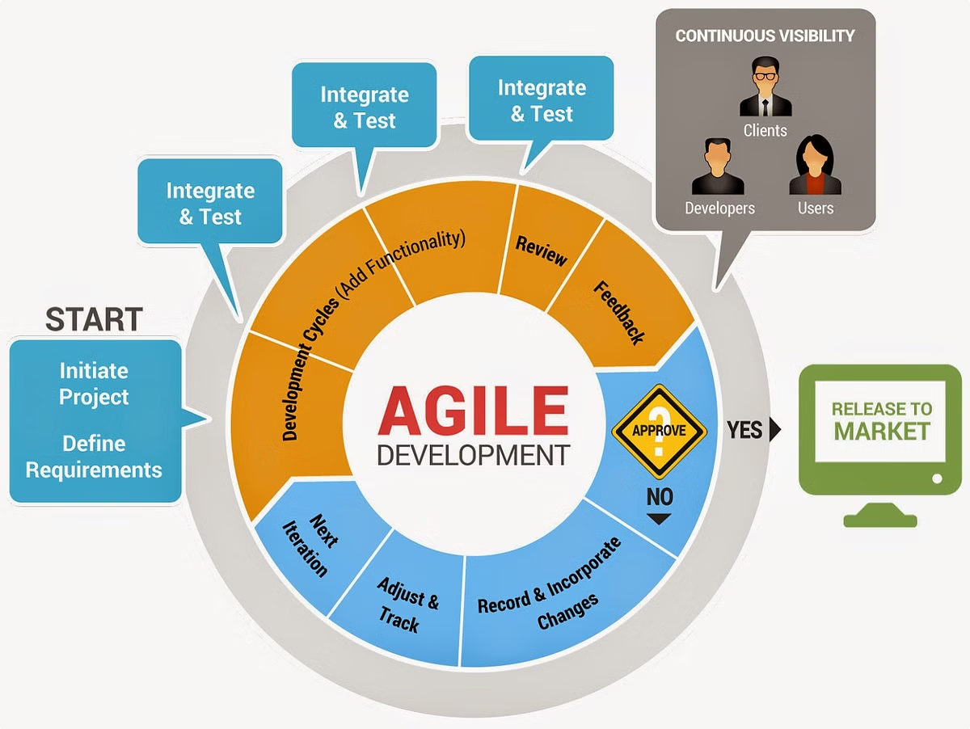



Vivekanand Education Society’s Institute Of Technology
Department Of Information Technology
DSA mini Project
A.Y. 2024-25
Implementation and Testing
Design
Finalize the system architecture and data flow, and create detailed design specifications.
Coding
Implement the queue data structure and related billing algorithms in C language.
Testing
Perform unit, integration, and end-to-end testing to ensure the system meets requirements.
Deployment
Deploy the billing system in a production environment and monitor its performance.

Slide 10


Vivekanand Education Society’s Institute Of Technology
Department Of Information Technology
DSA mini Project
A.Y. 2024-25
Conclusion and Future Enhancements
1
Successful Project
2
Future Scope
The mini project successfully demonstrated the application of data structures and algorithms in the context of a Telecom Billing System.
Explore machine learning techniques for intelligent data analysis, fraud detection, and personalized customer services.
3
Scalability
Investigate distributed and cloud-based architectures to further enhance the system's scalability and resilience.

Slide 11

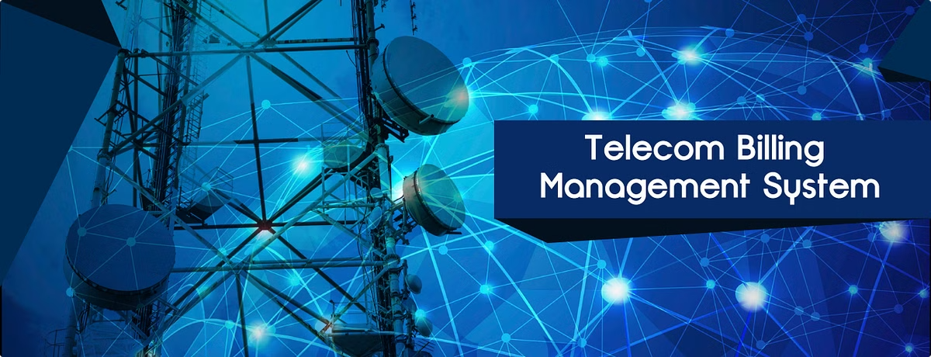
Vivekanand Education Society’s Institute Of Technology
Department Of Information Technology
DSA mini Project
A.Y. 2024-25
References and Acknowledgments
A Best Practice of Enterprise Information Integration
Platform in Telecom Industry. Ju-Ting Teng
Billing Information Laboratory.
Design and implementation of Telecom Buisness Management system
Efficiently Scheduling Cloud Resources for Peal( or
Urgent Events in Telecom System
dsa tp 1.pdf
dsa tp 2.pdf

